Slide 1
Estimating Uncertainty

Slide 2
Estimating Uncertainty in ADMB
Model parameters and derived quantities
Normal approximation
Profile likelihood
Bayesian MCMC
Bootstrap and Monte Carlo simulation (implement yourself see previous module)

Slide 3
Standard deviation calculations: Sdreport_ parameters
All estimated model parameters in sd report
Derived parameters need to be defined as sdreport_ parameters in the PARAMETER_SECTION
Uses delta method to calculate standard deviations for derived quantities

Slide 4
Sdreport_ parameters
DATA_SECTION
init_number Nobs
init_vector X(1,Nobs)
init_vector Y(1,Nobs)
init_number sd
PARAMETER_SECTION
init_number a
init_number b
sdreport_vector Ypred(1,Nobs)
objective_function_value f
PROCEDURE_SECTION
Ypred=a+b*X;
f=0.5*norm2((Y-Ypred)/sd);

Slide 5
*.std report
index name value std dev
1 a 4.4667e+000 6.8313e+000
2 b 9.9879e+000 1.1010e+000
3 Ypred 1.4455e+001 5.8775e+000
4 Ypred 2.4442e+001 4.9848e+000
5 Ypred 3.4430e+001 4.1923e+000
6 Ypred 4.4418e+001 3.5675e+000
7 Ypred 5.4406e+001 3.2098e+000
8 Ypred 6.4394e+001 3.2098e+000
9 Ypred 7.4382e+001 3.5675e+000
10 Ypred 8.4370e+001 4.1923e+000
11 Ypred 9.4358e+001 4.9848e+000
12 Ypred 1.0435e+002 5.8775e+000

Slide 6
*.cor report
The logarithm of the determinant of the hessian = -2.49496
index name value std dev 1 2 3 4 5 ………..
1 a 4.4667e+000 6.8313e+000 1.0000
2 b 9.9879e+000 1.1010e+000 -0.8864 1.0000
3 Ypred 1.4455e+001 5.8775e+000 0.9962 -0.8429 1.0000
4 Ypred 2.4442e+001 4.9848e+000 0.9789 -0.7730 0.9929 1.0000
5 Ypred 3.4430e+001 4.1923e+000 0.9311 -0.6565 0.9592 0.9860 1.0000
6 Ypred 4.4418e+001 3.5675e+000 0.8207 -0.4629 0.8671 0.9202 0.9725 ………
……………………………..
……………………………..

Slide 7
Profile likelihood calculations: likeprof_ parameters
Have to define a likeprof_ variable for both model parameters and derived quantities

Slide 8
likeprof_ parameters
DATA_SECTION
init_number Nobs
init_vector X(1,Nobs)
init_vector Y(1,Nobs)
init_number sd
PARAMETER_SECTION
init_number a
init_number b
sdreport_vector Ypred(1,Nobs)
likeprof_number a_prof
objective_function_value f
PROCEDURE_SECTION
a_prof=a;
Ypred=a+b*X;
f=0.5*norm2((Y-Ypred)/sd);

Slide 9
Executing profile likelihoods
Command line option
-lprof
e.g.
simple -lprof

Slide 10
*.plt report (a_prof.plt)
a_prof:
Profile likelihood
-18.467 0.000462415
-17.4911 0.000800741
-16.5152 0.00113907
-15.5393 0.00147739
…….
Minimum width confidence limits:
significance level lower bound upper bound
0.9 -8.59448 16.6654
0.95 -10.6598 18.9582
……..
One sided confidence limits for the profile likelihood:
……..
Normal approximation
-18.467 0.000461949
-17.4911 0.000800021

Slide 11
Controlling the profile likelihood calculations
PRELIMINARY_CALCS_SECTION
a_prof.set_stepnumber(10);
a_prof.set_stepsize(0.1);
Step is in standard deviation units

Slide 12
Exercise: comparing estimates of uncertainty
Modify the code to make a profile likelihood for the predicted Y on observation 3
Compare the profile likelihood confidence intervals to those based on the normal approximation using the estimated standard deviation

Slide 13
Why Bayesian analysis?
Include all information
  Previous experiments
  Other populations/species
  Expert judgment
Calculate probabilities of alternative hypotheses
Estimate uncertainty
Easy to implement

Slide 14
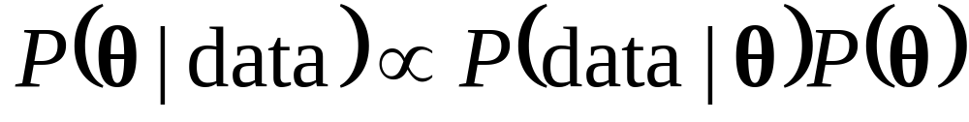
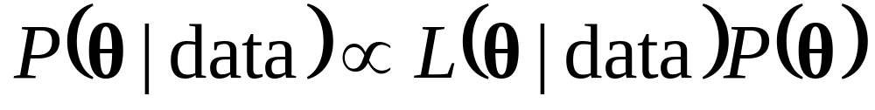
Priors
Support from
Data
Support from
Prior
Notes:
-The posterior distribution is proportional to the likelihood multiplied by the prior probability of the parameters.
-The prior distribution provides additional information to the analysis that is available before the data is analyzed.
-The prior information can come from other experiments or data sets for the same population,
data from other populations,
or from expert opinion or theory.

Slide 15
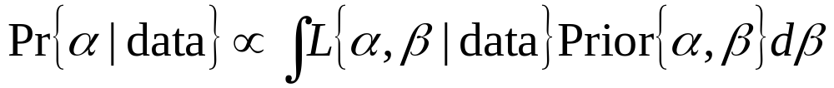
Integration

Slide 16
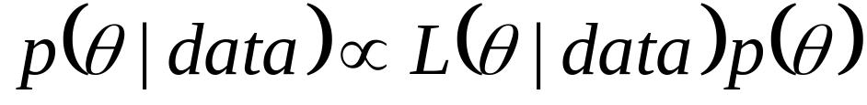
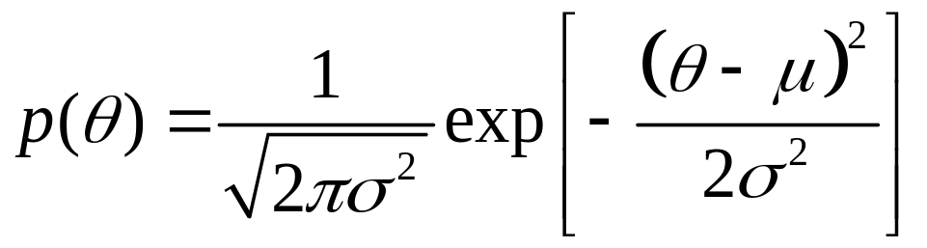
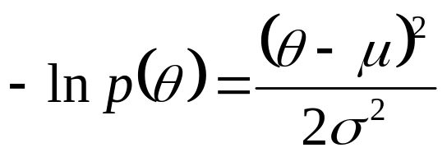
Priors

Slide 17
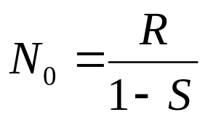


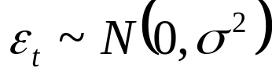
Simple Fisheries Model

Slide 18
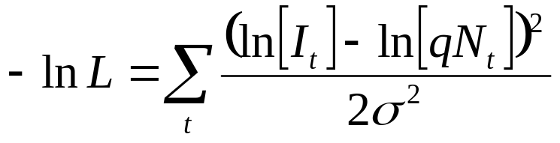
Likelihood (ignoring constants sd known)

Slide 19
Simple Fisheries Model (fish.tpl)
DATA_SECTION
init_number S
init_number sigma
init_int Nyears
init_vector C(1,Nyears)
init_int Nobs
init_matrix CPUE(1,Nobs,1,2)
PARAMETER_SECTION
init_number R
init_number q
vector N(1,Nyears+1)
objective_function_value f

Slide 20
PROCEDURE_SECTION
f=0;
N(1)=R/(1-S);
for(int year=1;year<=Nyears;year++)
{
N(year+1)=S*N(year)+R-C(year);
}
for(int obs=1;obs<=Nobs;obs++)
{
f+= 0.5*square((log(CPUE(obs,2))-log(N(CPUE(obs,1))*q) ) / sigma)
}
Allows missing years

Slide 21
Data file
#survival
0.7
#sigma
0.4
#Nyears
26
#catch
0 6 6 6 18 38 68 . . . . .
#nobs
26
#CPUE (year index)
1 0.973
2 1.054
. .
. .

Slide 22
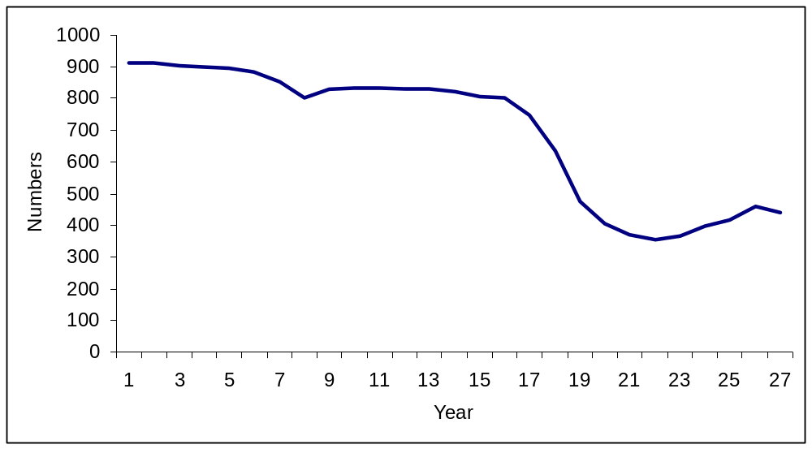
Results
# Number of parameters = 2 Objective function value = 2.19824 Maximum gradient component = 7.77976e-06
# R:
272.859
# q:
0.000821747

Slide 23
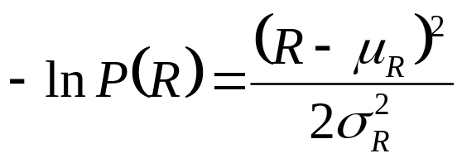
Bayesian Version
Uniform vs log-Uniform prior on q
Normal prior on R with bounds (ignoring constants)

Slide 24
Bayesian Version
DATA_SECTION
init_number Rmean
init_number Rsigma
init_int qtype
init_number qlb
init_number qub
.
.
PARAMETER_SECTION
init_bounded_number R(1,1000)
init_bounded_number q(qlb,qub)
number qtemp
likeprof_number Rtemp
.
.
Notes:
Bounds stop the MCMC choosing numbers that may cause problems in the calculations
Likeprof defines a parameter that will have its profile or posterior calculated

Slide 25
Bayesian Version
PROCEDURE_SECTION
Rtemp=R;
.
.
if (qtype==0) qtemp=q;
else qtemp=exp(q);
.
(likelihood calculation using qtemp)
.
f+=0.5*square((R-Rmean) / (Rsigma));
Notes:
Need to change bounds in .DAT to be Ln(bound)
Need to change q value in .PIN file to be Ln(q)

Slide 26
Data File (check the sd)
#Rprior
#Rmean
300
#Rsigma
300
#qprior
#type 0=uniform, 1=uniform on logscale
0
#lb //note need to change depending on type
0.000001
#ub //note need to change depending on type
1
#survival
0.7
.
. //note: also need to change pin file for q depending on type

Slide 27
Profiles and Posteriors
Likelihood Profile (with prior information)
  -lprof
  Parameter.PLT
MCMC Bayesian Posterior
  -mcmc 100000
  .HST

Slide 28
Rtemp.plt (log q)
Rtemp:
Profile likelihood
130.024 9.49848e-53
137.557 9.49848e-53
. . .
526.417 3.04463e-05
533.206 2.00067e-05
Minimum width confidence limits:
significance level lower bound upper bound
0.9 223.593 379.097
. . .
One sided confidence limits for the profile likelihood:
The probability is 0.9 that Rtemp is greater than 247.276
. . .
The probability is 0.9 that Rtemp is less than 369.234
. . .
Normal approximation
130.024 4.91481e-05
137.557 7.3114e-05
. . .
526.417 3.92509e-10
533.206 1.29315e-12
Minimum width confidence limits:
significance level lower bound upper bound
0.9 204.167 344.451
. . .

Slide 29
bayes.hst (log q)
# samples sizes
100000
# step size scaling factor
1.44
# step sizes
11.4112
# means
300.431
# standard devs
91.3469
# lower bounds
-10
# upper bounds
25
#number of parameters
2
#current parameter values for mcmc restart
258.716 -7.04783
#random nmber seed
1992392945
#Rtemp
186.319 0
197.73 1.13923e-05
209.141 0.000134079
220.552 0.000889475
…

Slide 30
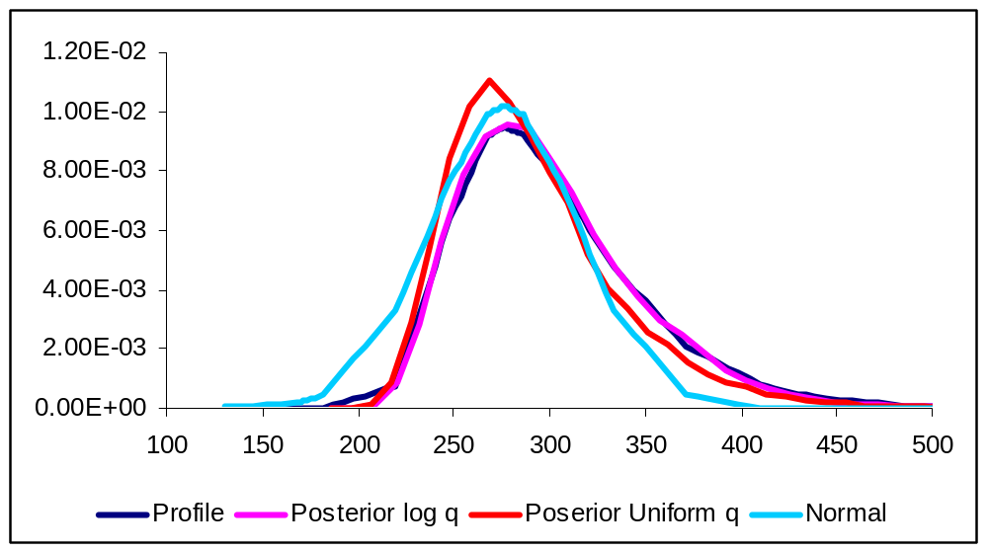
Results

Slide 31
Exercise
Add normal prior on survival with mean 0.7 and sd 0.2.
Estimate survival in phase 2
Compare results for average recruitment with those from the analysis with fixed S
Use a uniform on the log-scale prior for q

Slide 32
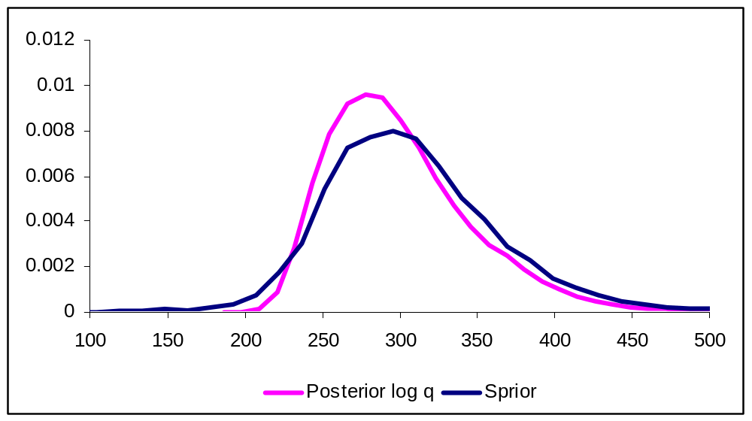
Results

Slide 33
Decision Analysis
  -mcmc 100000 -mcsave 100
  -mceval

Slide 34
Decision Analysis
DATA_SECTION
init_int Nprojectyears
init_number projectcatch
…
PARAMETER_SECTION
vector N(1,Nyears+1+Nprojectyears)
PROCEDURE_SECTION
f=0;
dynamics();
likelihood();
if (mceval_phase()) decision();
Rtemp=R;

Slide 35
Functions
FUNCTION decision
for(int year=Nyears+1;year<=Nyears+Nprojectyears;year++)
{
N(year+1)=S*N(year)+R-projectcatch;
if (N(year+1)<=0)
{
N(year+1)=0;
}
}
ofstream out("posterior.dat",ios::app);
out<<R<<" "<<q<<" "<<N(1)<<" "<<N(Nyears+1)<<“ “
<<N(Nyears+Nprojectyears+1)<<"\n";
out.close();

Slide 36
Notes
Delete posterior.dat before starting or it will contain the old data
Can change decision and run –mceval without rerunning -mcmc
posfun

Slide 37
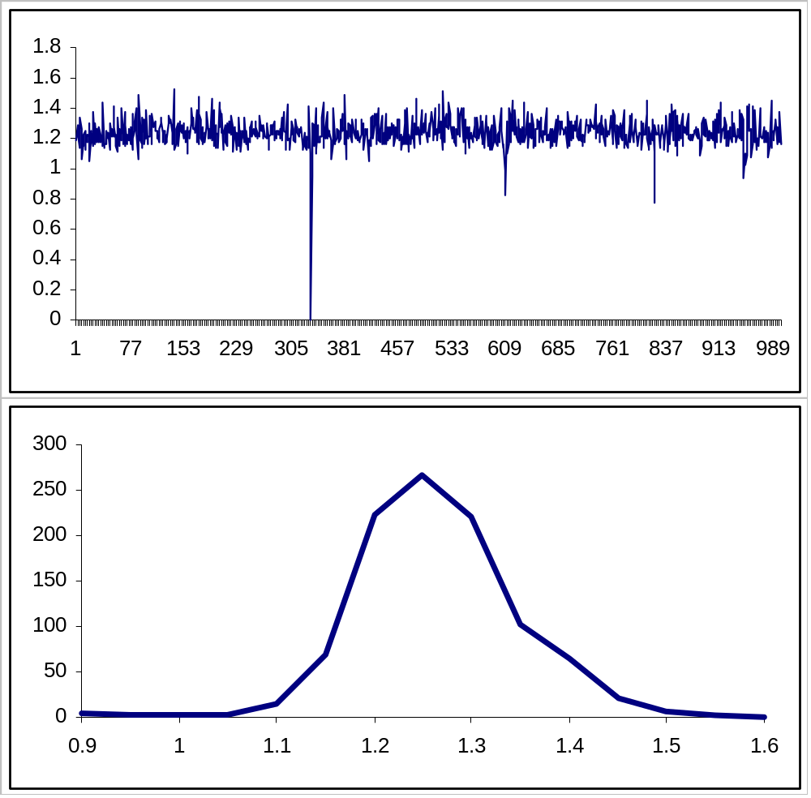
Results – Nproj/Ncur

Slide 38
Add random recruitment
DATA_SECTION
init_number Rsd
…
vector Rdev(Nyears+1, Nyears+Nprojectyears+1)
!!rec_seed=1211;
FUNCTION decision
Rdev.fill_randn_ni(rec_seed);
…
N(year+1)=S*N(year)+R*mfexp(Rdev(year+1)*Rsd-0.5*Rsd*Rsd)-projectcatch;
GLOBALS_SECTION
long int rec_seed; //cant do in DATA_SECTION and if use !! It will only be local

Slide 39
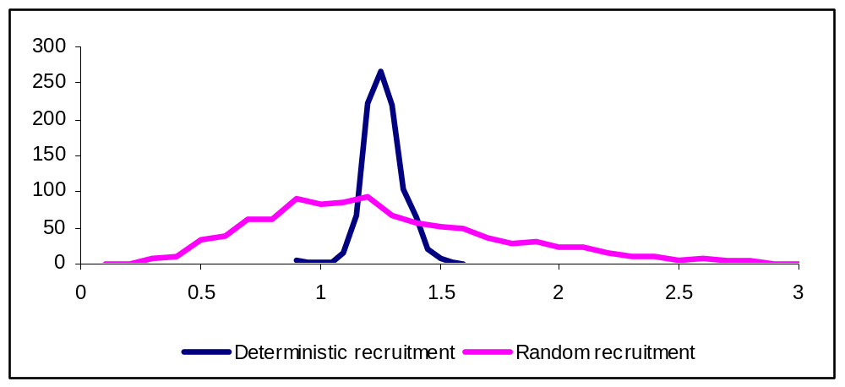
Results - Nproj/Ncur

Slide 40
END

Slide 41
Exercise: use harvest rate strategy
Start with file decision.tpl
Use projectcatch as a harvest rate = 0.3 only for the projection time period
Calculate catch [define a vector]
Report average catch in decision file [use mean()]
Probably don’t need to run mcmc again, only mceval

Slide 42
Harvest strategy
PARAMETER_SECTION
…
vector Cproj(Nyears+1,Nyears+Nprojectyears)
FUNCTION decision
…
//old code
//N(year+1)=S*N(year)+R*mfexp(Rdev(year+1)*Rsd-0.5*Rsd*Rsd)-projectcatch;
//new code
N(year+1)=(S*N(year))*(1-projectcatch)+R*mfexp(Rdev(year+1)*Rsd-0.5*Rsd*Rsd);
Cproj(year)=(S*N(year))*projectcatch;
…
out<<R<<" "<<q<<" "<<N(1)<<" "<<N(Nyears+1)<<" "<<N(Nyears+Nprojectyears+1)<<" "<<Rdev(Nyears+Nprojectyears)<<" "<<mean(Cproj)<<"\n";

Slide 43
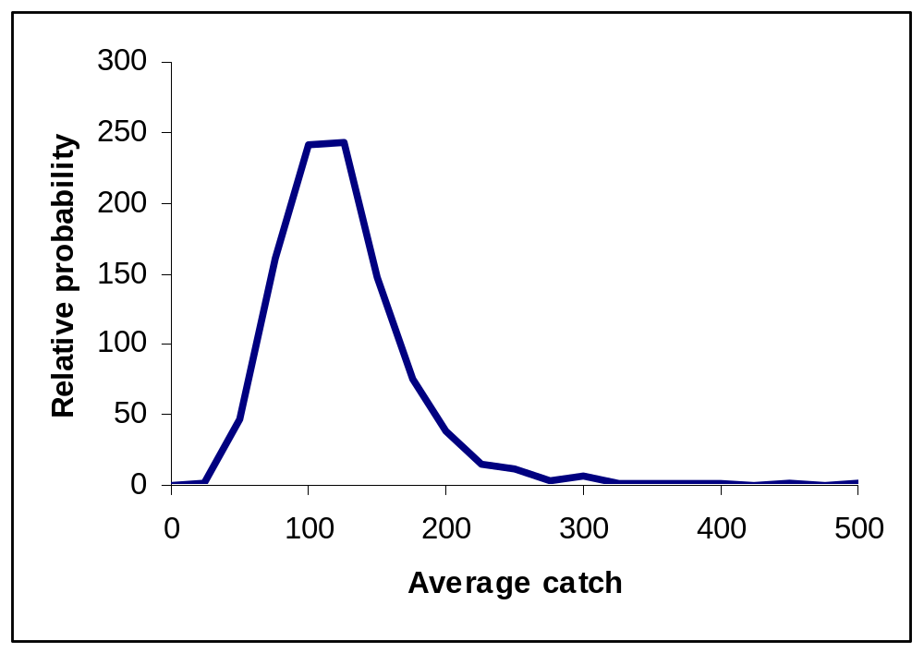
Results
(catch after survival and before recruitment)

Slide 44
Example
Tagging to estimate survival
A stock assessment model fit to C@L and index of abundance
Use prior on survival in stock-assessment model based on the results of the tagging analysis
Both tagging data and C@L provide information on survival

Slide 45
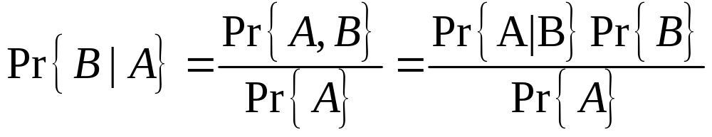
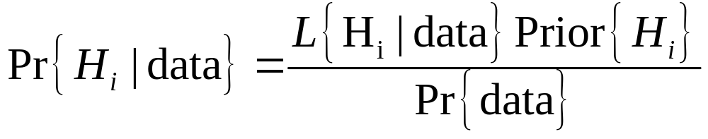
Bayes’ Theorem
Note the different order for a probability and a likelihood

Slide 46
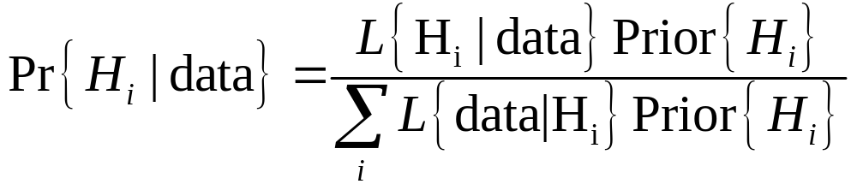
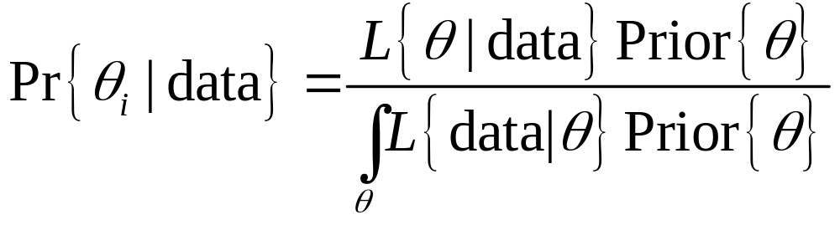
Calculating the denominator
Discrete hypotheses
Continuous parameters (need to change H)

Slide 47


Bayesian methods for parameters
Posterior is proportional to the likelihood multiplied by the Prior

Slide 48
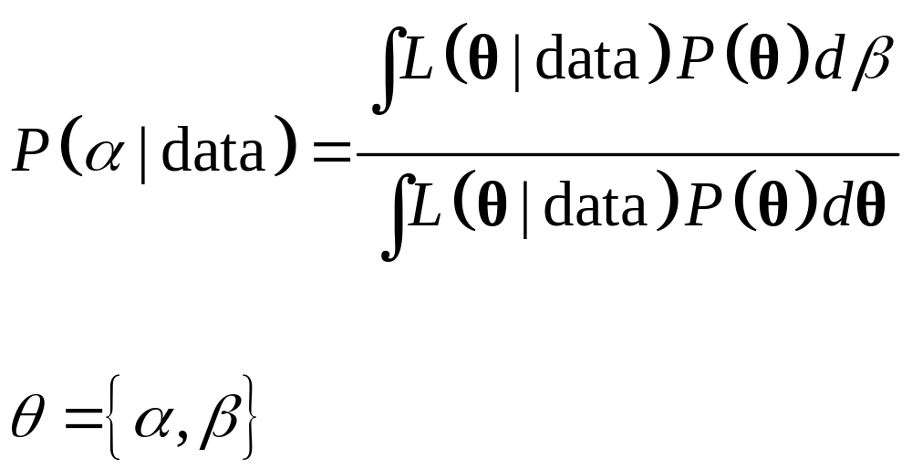
Two characteristics of Bayesian analysis
Integration
Prior
Notes:
-Bayesian analysis has two characteristics that differentiate it from other methods of statistical inferences.
-The first is the use of priors for the parameters of the model
-And the second is the integration over the parameter space

Slide 49
Priors
  From other experiments/data sets on same population
  e.g. analysis of mark-recapture data for survival as a prior for a Lesley matrix fit to abundance trends
  From other populations/species
  e.g. survival for bigeye tuna in the Atlantic used in an assessment of bigeye tuna in the Pacific
  From expert opinion/experience/theory
  e.g. survival is high for albatross
Notes:
-The posterior distribution is proportional to the likelihood multiplied by the prior probability of the parameters.
-The prior distribution provides additional information to the analysis that is available before the data is analyzed.
-The prior information can come from other experiments or data sets for the same population,
data from other populations,
or from expert opinion or theory.

Slide 50
Exercise
Do a profile likelihood
MCMC with uniform prior on q
MCMC with uniform on the log scale for q
Plot these as well as the normal approximation
Don’t forget to make the bounds and pin on the correct scale for q. I have appropriate values commented out. Keep upper bound on q = 1 for both.

Slide 51
Convergence
Read Punt and Hilborn
Delete the initial burn in period
Thin the chain (i.e. save every xth value) to reduce auto-correlation and limit the number of forward projections

